Slide 1
PC Maintenance: Preparing for A+ Certification
Chapter 30: Optimizing and Troubleshooting Windows

Slide 2
Chapter 30 Objectives
Understand how to identify and avoid viruses
Become familiar with the major Windows system utilities

Slide 3
Types of Virus Infections
Trojan horse
Worm
@m mailer
@mm mass mailer
Back door
Blended threat

Slide 4
How Viruses Spread
Booting from an infected disk
Running an infected program or macro
Worms can spread from PC to PC via e-mail or P2P file sharing

Slide 5
Symptoms of Infection
Degradation in system performance
Spontaneous reboots
odd e-mails
Word saves in DOT format only
Double-extension on recently opened file
Antivirus application will not install, or disabled
New users with full security permissions
File sizes/dates changed
Files disappear
System will not boot normally

Slide 6
Virus Definitions
Definition file contains tell-tale code strings for known viruses and worms
Keep definitions up to date

Slide 7
Avoid Future Infections
Do not open unexpected attachments
Keep Windows and IE patched
Disable extra services that are unused
Do not boot from an unknown floppy
Use strong passwords
Update virus definitions frequently

Slide 8
Disk Defragmenter
Increases performance by decreasing fragmentation
Fragmentation makes files take longer to load
Disable background applications before defragmenting
Run from Start, Programs, Accessories, System Tools menu

Slide 9
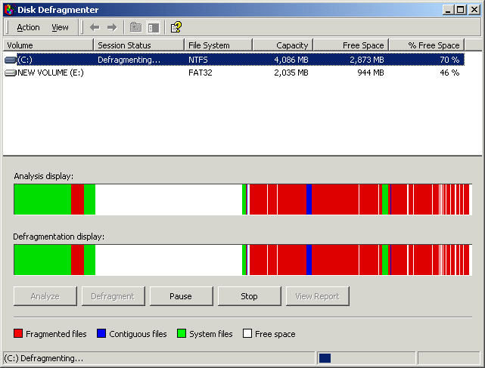
Disk Defragmenter

Slide 10
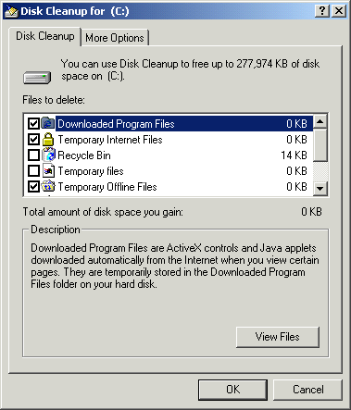
Disk Cleanup
Frees up space by recommending files to be deleted
Comes with all versions except Windows 95
Start, Programs, Accessories, System Tools

Slide 11
FAT32 Converter
Comes only with Windows 98
Converts FAT16 to FAT32

Slide 12
DriveSpace
Comes only with DOS, Win95, and Win98
Compresses FAT16 drives to save disk space
Does not work with FAT32 or NTFS
Drives take longer to defragment

Slide 13
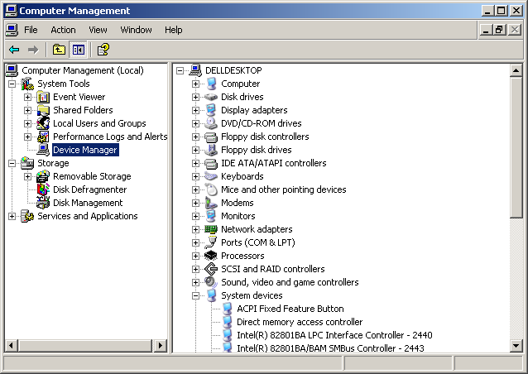
Computer Management
Windows 2000/XP utility
Found in Administrative Tools in Control Panel

Slide 14
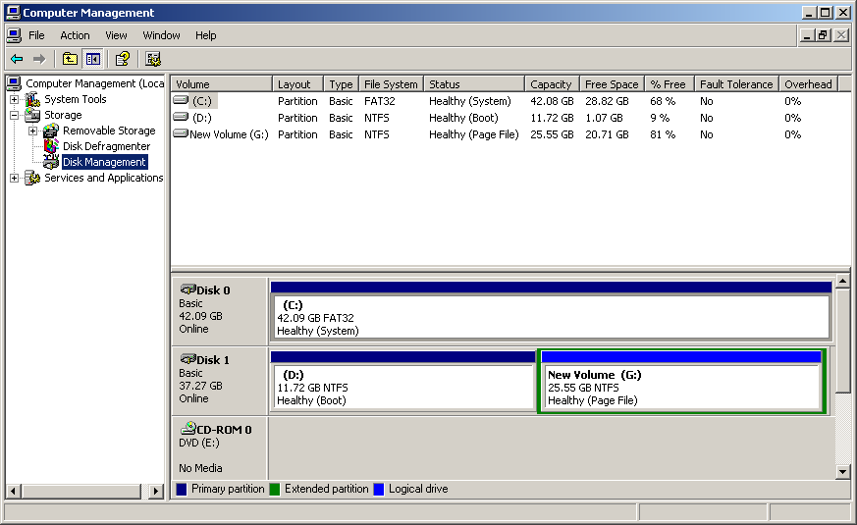
Disk Management
Found within Computer Management
Partition and format disks
Examine disk properties

Slide 15
Microsoft Management Console (MMC)
Customizable version of Computer Management
Can access other computers on the network
Starts out blank
Snap-ins add functionality

Slide 16
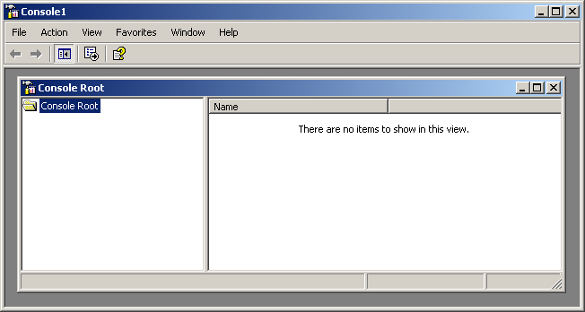
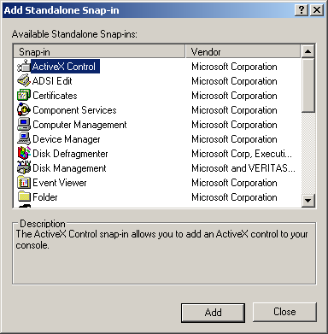
Microsoft Management Console

Slide 17
Hardware Diagnostic Tool (HWINFO)
Windows 98 and Windows Me only
Different view of same information as System Information
Run with the /UI switch from the Run command: HWINFO /UI

Slide 18
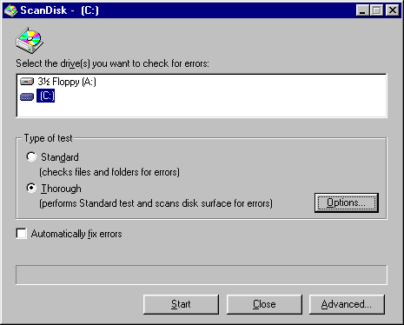
Scan Disk
Finds and fixes file system errors
Optionally can check hard disk for physical errors too
Exists in 2000/XP but called Check Disk instead

Slide 19
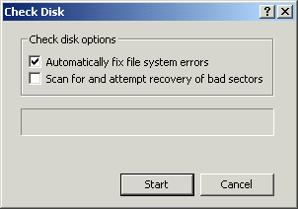
Check Disk
Windows 2000/XP version of Scan Disk

Slide 20
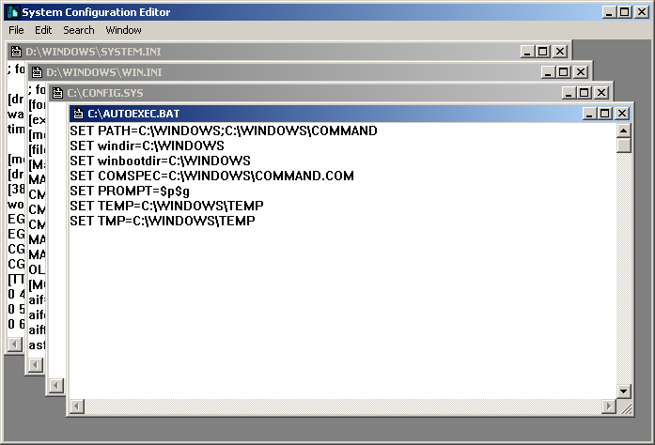
System Configuration Editor (SYSEDIT)

Slide 21
Registry Editor
REGEDIT
  Primary Registry editor utility, in all versions
REGEDT32
  Different version in most Windows versions
  In Windows XP, running REGEDT32 redirects you to REGEDIT
SCANREG
  Registry checker, available in 98 and Me only

Slide 22
Other Utilities
Dr. Watson
Automatic Skip Driver (ASD)
Task Scheduler
Windows Scripting Host (WSCRIPT)

